Slide 1
NLP Session 3
Recurrent Neural Networks
RNN · BPTT · GRU · LSTM
Sequence Modeling
Backpropagation Through Time
Vanishing Gradient
Long Short-Term Memory
Deep Learning | NLP

Slide 2
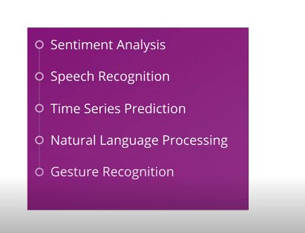
What is a Recurrent Neural Network?
Key Idea
RNNs process sequential data by maintaining a hidden state that carries information across time steps — giving the network a form of memory.
Core Equations
Sₜ = tanh(W·Sₜ₋₁ + U·Xₜ)
Oₜ = V · Sₜ
Weight Roles
W → shared weight across time (hidden state)
U → weight for input Xₜ
V → weight for output / softmax
Applications
Sentiment Analysis
Speech Recognition
Time Series Prediction
NLP
Gesture Recognition

Slide 3
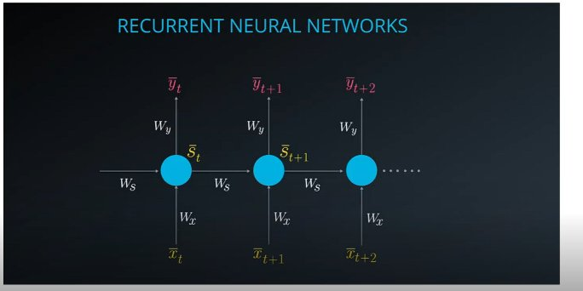
Unfolded RNN Architecture
Xₜ
Sₜ
Yₜ
Input Vector
Hidden State
Output Vector
One-hot encoded word, passed through word embedding before entering the RNN.
Memory of the network. Computed from the previous state and current input using tanh.
Generated when output is needed (ŷ); otherwise the state is passed forward as memory.

Slide 4
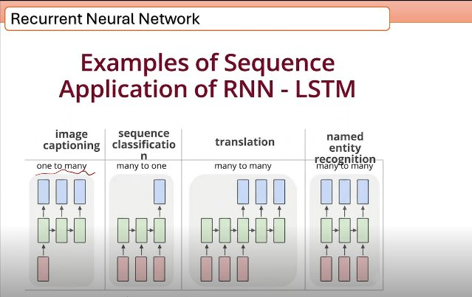
Sequence Application Types
One-to-Many
Image Captioning — single image input, sequence output.
Many-to-One
Sequence Classification — full sequence in, single label out.
Many-to-Many
Translation & NER — full sequence in, full sequence out.
Input uses one-hot encoding + word embeddings before entering the RNN.

Slide 5
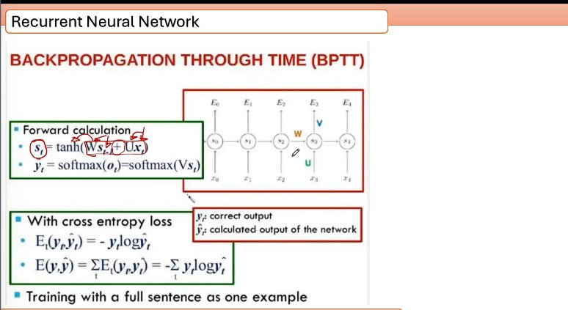
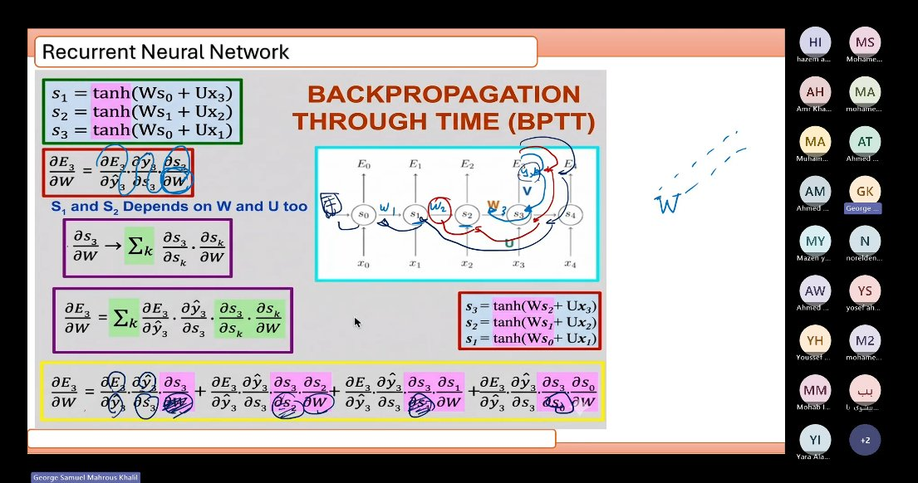
Backpropagation Through Time (BPTT)
Loss Function
Eₜ(yₜ, ŷₜ) = −yₜ log ŷₜ
E(y,ŷ) = ΣEₜ(yₜ, ŷₜ)
BPTT Logic
Because weights W, U, V are shared across all time steps, gradients must be summed across every time step where they contributed.
Training
A full sentence is treated as one training example.

Slide 6
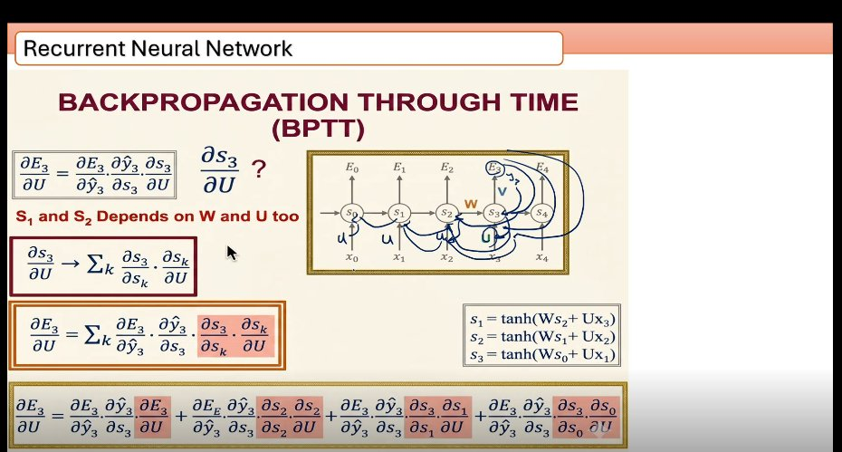
BPTT — Gradient Derivations
∂E/∂W — Weight shared across time
∂E/∂U — Input weight gradient

Slide 7
Vanishing Gradient Problem
⚠ The Problem
✓ The Solution
During BPTT, gradients are multiplied repeatedly across many time steps. When values are < 1, they shrink exponentially — the network stops learning long-range dependencies.
GRU and LSTM architectures introduce gating mechanisms that allow gradients to flow unchanged over long sequences — solving the vanishing gradient problem.
→
GRU — Gated Recurrent Unit
Reset Gate (G_r)
Update Gate (G_u)
Activation: Sigmoid
Activation: Sigmoid
Decides how much of the previous state to forget.
Decides how much of the current candidate state to keep.

Slide 8
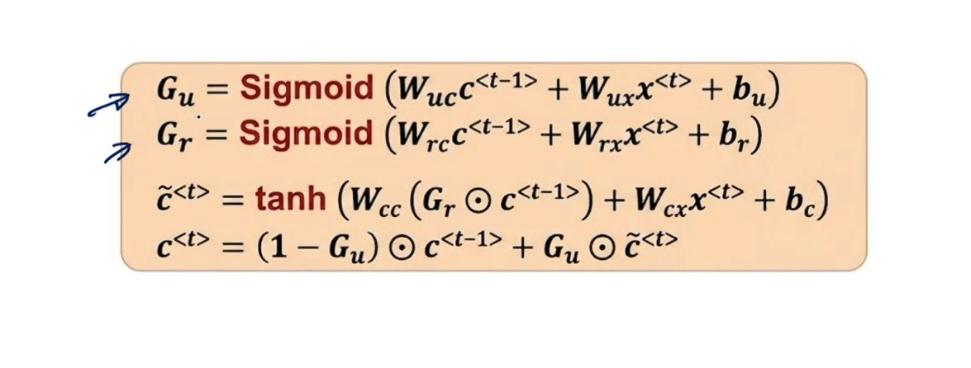
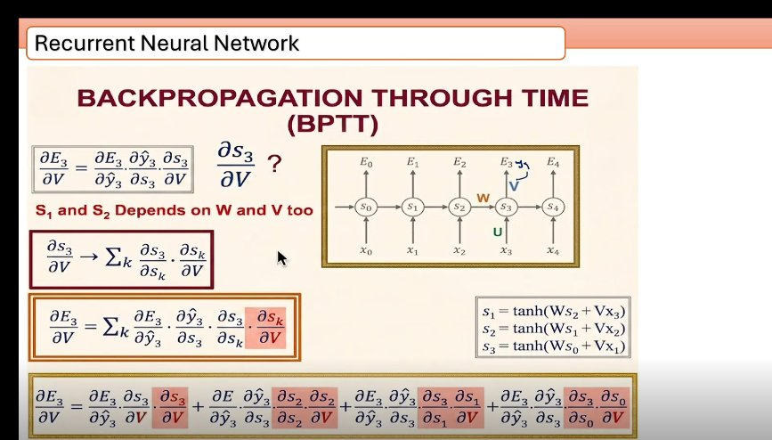
GRU — Equations & Architecture
G_u = Sigmoid(…)
c̃⁽ᵗ⁾ = tanh(…)
Update gate: learns what fraction of previous memory to keep.
Candidate hidden state: new information from input + filtered prev state.
G_r = Sigmoid(…)
c⁽ᵗ⁾ = (1−G_u)⊙c⁽ᵗ⁻¹⁾ + G_u⊙c̃⁽ᵗ⁾
Reset gate: controls how much previous state influences the candidate.
Final state: blend of old memory and new candidate.

Slide 9
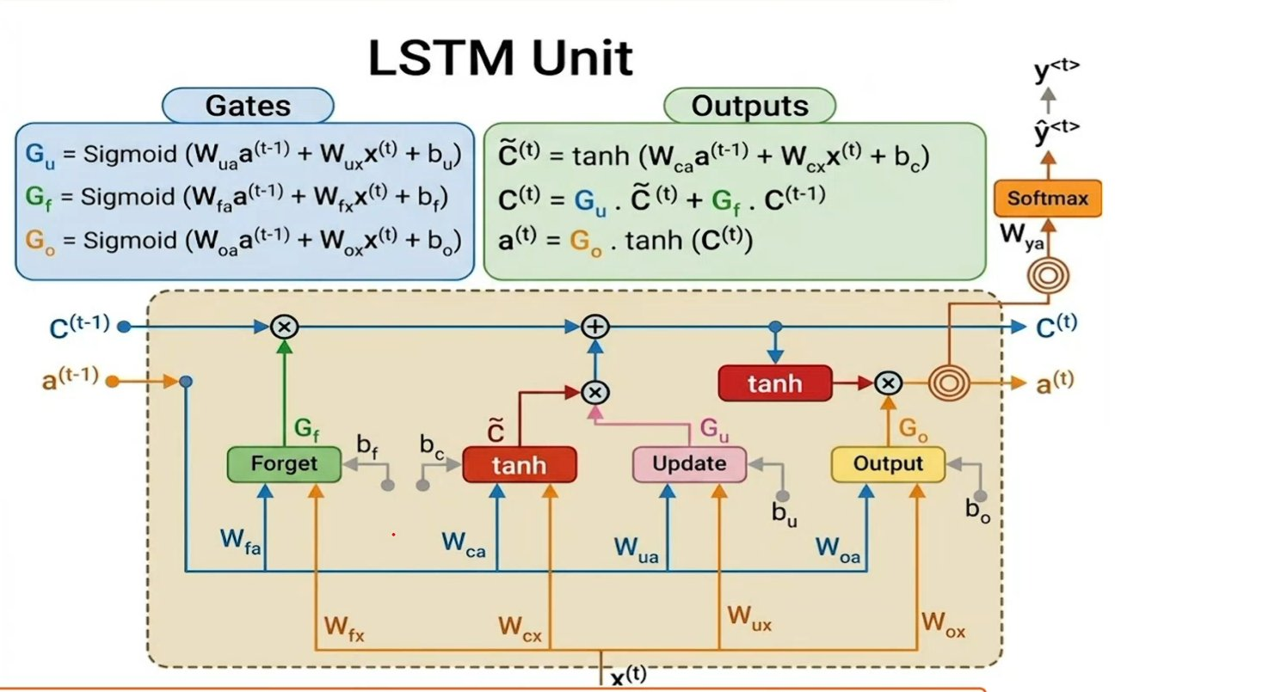
LSTM — Long Short-Term Memory (1997)
Forget Gate G_f
Update Gate G_u
Output Gate G_o
What to remove from cell state
What new info to write to cell
What to output from cell state

Slide 10
RNN vs GRU vs LSTM — Summary
Vanilla RNN
GRU
LSTM
Simple architecture
Hidden state carries memory
Shared weights W, U, V
Suffers from vanishing gradient
Poor on long sequences
2 gates: Reset & Update
Lighter than LSTM
Good balance speed/accuracy
Fixes vanishing gradient
Fewer parameters
3 gates: Forget/Update/Output
Separate cell state + hidden state
Best long-term memory
Proposed in 1997
More parameters, more powerful

Slide 11
Key Takeaways
RNNs process sequences by maintaining hidden state across time steps.
BPTT propagates gradients backward through unrolled time steps, summing over shared weights.
Vanishing Gradient limits vanilla RNN performance on long sequences.
GRU uses Reset & Update gates to selectively retain or discard information.
LSTM uses three gates and a cell state to achieve powerful long-term memory (1997).
NLP Session 3 · Recurrent Neural Networks

